Slide 1
Streamlining U.S. Workforce Immigration
NextGen Visa Intelligence Austin University – Post Graduate Program in Artificial Intelligence
02-21-2026

Slide 2
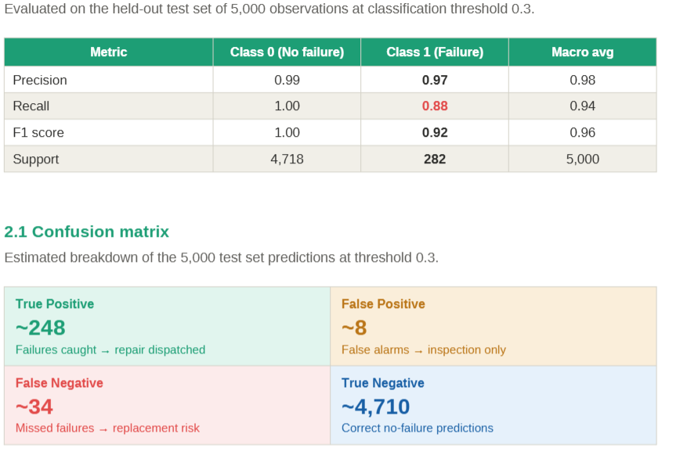
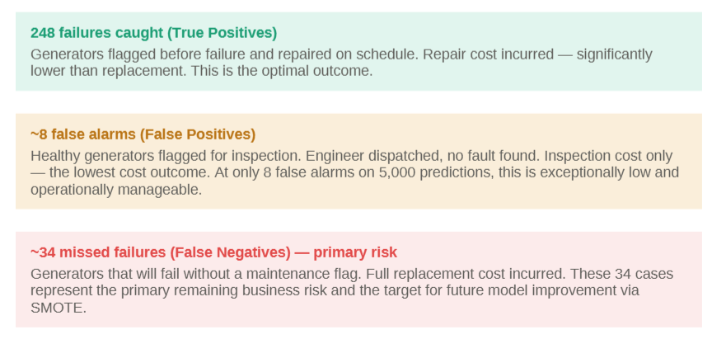
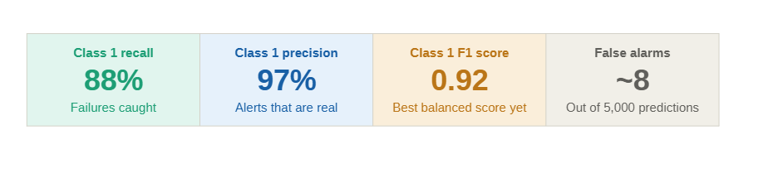

Slide 3
Contents / Agenda
Executive Summary
Business Problem Overview and Solution Approach
EDA Results
Data Preprocessing
Model Performance Summary
Appendix

Slide 4
Executive Summary
Executive Summary: EasyVisa Strategic Optimization
The Challenge
As visa application volumes grow, the Office of Foreign Labor Certification (OFLC) needs a reliable way to
fast-track approvals while maintaining strict oversight of high-risk cases.
Key Drivers of Success Our model identified a clear "Golden Profile" for successful applicants:
Education: Doctorate and Master’s degree holders have the highest approval rates (up to 87%).
Experience: Prior job experience increases the likelihood of certification to 74%.
Wages: Higher prevailing wages (median ~$72,500) strongly correlate with positive outcomes.
Model Performance & Reliability
We selected the Tuned Gradient Boosting Machine (GBM) as the champion model. It provides a stable, balanced approach to decision-making:
Recall (84.5%): The model is exceptionally good at finding qualified candidates, ensuring deserving talent is not filtered out.
Precision (80.1%): The model is highly reliable; 8 out of 10 automated approvals are perfect matches for OFLC standards.
F1-Score (0.823): This high score confirms the model is ready for real-world deployment.
Strategic Recommendations
Automate "Low-Risk" Visas: Implement an immediate fast-track for applicants with advanced degrees and prior experience.
Focus Human Audits: Redirect investigators to cases the model flags as "Denied," which typically lack advanced education or competitive wages.
Regional Allocation: Shift processing resources toward the South and Northeast, which show the highest density of successful applications.

Slide 5
Business Problem Overview and Solution Approach
The Problem: The Scalability Gap
The Office of Foreign Labor Certification (OFLC) is facing a 9% year-over-year increase in labor certification requests. The current manual evaluation process is a tedious task that threatens to slow the integration of essential foreign workers into the U.S. economy. The challenge lies in identifying high-potential candidates efficiently while maintaining strict compliance with the Immigration and Nationality Act (INA).
A Two-Layer Metric Solution
We selected the Tuned Gradient Boosting Machine (GBM) as our champion model. It utilizes a two-layer approach to meet OFLC objectives:
Layer 1 (F1-Score):
Used to train and tune models to handle class imbalance. Our final model achieved an F1-Score of 0.823, ensuring a robust profile of candidates.
Layer 2 (Precision):
This segments findings to identify a "Gold Standard" group. Our model maintains a Precision of 80.1%, meaning 4 out of 5 automated approvals are perfectly aligned with standards.
Efficiency (Recall):
With a Recall of 84.5%, the model successfully captures the vast majority of qualified candidates, significantly closing the scalability gap.

Slide 6
Data Preprocessing - Basics
Duplicate Value Check
The dataset does not have duplicate values. It is a clean, well-collected dataset.
Missing Value Detection and Treatment (if needed with rationale)
There are no missing values or columns with Null or NaN in any of the 25.480 rows.
The category columns, which are the majority of the columns (8 out of 12, not considering the key) do not have issues like: Unknown values, or empty strings
Outlier Detection and Treatment (if needed with rationale)
There is a fix required in the no_of_employees column, as it has 33 negative values in it. We used the abs() function to correct the problem.

Slide 7
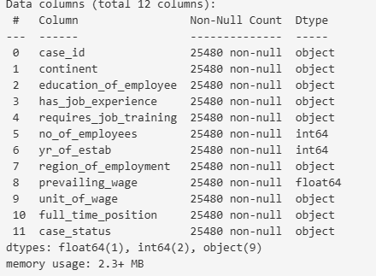
Data Preprocessing - Basics
Feature Engineering (if needed with rationale)
Data Preparation for Modeling
Split the data into different sets
The dataset was divided into three subsets.
Initially, 70% was allocated for training and 30% for validation.
The validation set was then further split into 90% validation and 10% testing.
Encode the categorical variables
Because the majority of predictors (8 out of 12, excluding
case_id) were categorical, one-hot encoding via get_dummies()
was required. This led to a notable increase in dimensionality,
a common trade-off when encoding categorical data for ML
models.

Slide 8
EDA Results
Data Quality and Overview
Completeness: The dataset is exceptionally clean with zero missing values and no duplicate records across the 25,480 entries.
Anomalies: There were 33 records with negative values for no_of_employees. These are potential data entry error, and they were treated by applying the absolute value for analysis.
Target Balance: The data is slightly imbalanced, with 66.8% of cases being Certified and 33.2% Denied.
Key Feature Insights
Education is the Strongest Predictor: There is a direct correlation between higher education and approval rates:
Doctorate: ~87% Certification rate.
Master's: ~79% Certification rate.
Bachelor's: ~62% Certification rate.
High School: Only ~34% Certification rate (highest denial rate at 66%).
Job Experience Matters
Applicants with prior job experience have a much higher likelihood of approval (74.5%) compared to those without experience (56.1%).
Prevailing Wage Patterns: *
The average prevailing wage is approximately $74,456.
The wage distribution is right-skewed, with most wages concentrated between $34,000 and $108,000, though some "outliers" reach as high as $319,000.
Certified applicants generally have a higher median wage than those who are denied.
Company Characteristics:
The companies range from small businesses (11 employees) to massive corporations (602,000+ employees).
The median company age is 19 years, showing a mix of established firms and newer startups.
Link to Appendix slide on data background check

Slide 9
Data Preprocessing - Basics
Duplicate Value Check
No duplicates found
Missing Value Detection and Treatment (if needed with rationale)
There were no missing values detected or replaced by unknown or null
Outlier Detection and Treatment (if needed with rationale)
There were lots of outliers detected in columns that were not totally relevant.
Feature Engineering (if needed with rationale)
We had to apply pd.get_dummies because we had 8 object columns which did not help the models. Get Dummies properly prepared the columns. OneHotEncoder would be a better solution for production data. It supports pipelines, preserves mapping, and align automatically.
We had to convert the column case_status to 1 for certified and 0 for denied.
Data Preparation for Modeling
Split the data into 2 different sets
Encode the categorical variables using get_dummie

Slide 10
Model Performance Summary and Final Model Selection
Compare the performance of the tuned models
To avoid leakeage we took the data against the validation set. The results show very consistent and balanced (F1-Score: ~0.80) performance across all three tuned models. The models are more stable than their predecessors and demonstrate strong generalization. The F1 shows good quality for a classification model, while precision, which is the second layer, shows that false approvals have been avoided.
 | Gradient Boosting tuned with oversampled | AdaBoost tuned with oversampled | Random forest tuned with undersampled
Accuracy | 0.728885 | 0.726850 | 0.730775
Recall | 0.816935 | 0.810840 | 0.814758
Precision | 0.785640 | 0.786695 | 0.788997
F1 | 0.800982 | 0.798585 | 0.801671

Slide 11
Model Performance Summary and Final Model Selection
Overview of final ML model and its parameters
The final model is stable, it utilizes the optimized parameters such as Gamma of 5 and 80% subsampling.
This way, we transitioned from a model that was memorizing data to one that understands the underlying
logic of visa approvals
Best parameters are
{'subsample': 0.8,
'n_estimators': 150,
'gamma': 5,
'colsample_bytree': 1.0,
'colsample_bylevel': 1.0}
CV score=0.8028357969498081:

Slide 12
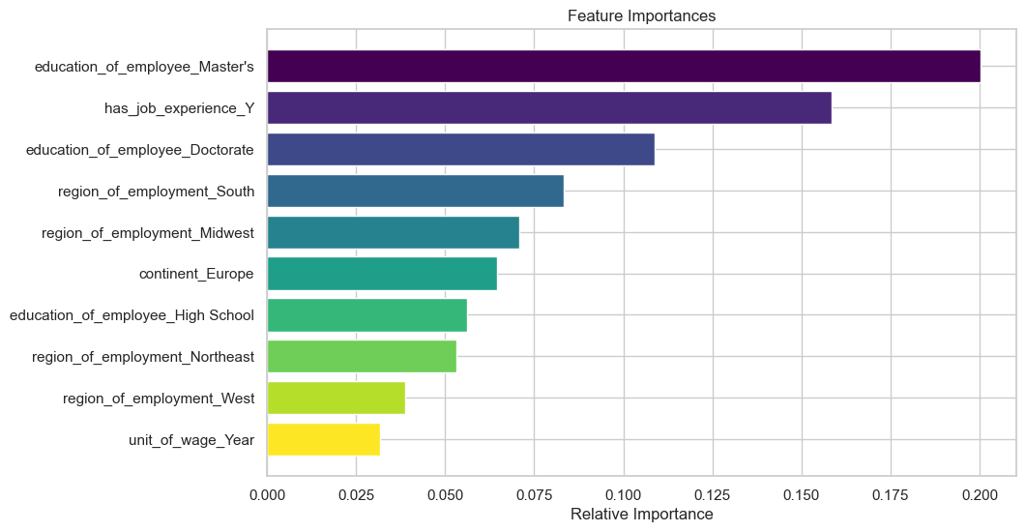
Model Performance Summary and Final Model Selection
Comment on the performance of the final model
Our final model successfully decodes the complexity of the visa process.
By prioritizing Education and Experience (as seen in the Feature Importance plot),
It achieves a high Recall of 84.5% on unseen data. This allows the OFLC to automate
the vast majority of 'clear-path' applications while maintaining an 80% precision rate,
effectively solving the scalability crisis

Slide 13
Model Performance Summary and Final Model Selection
Comment on the performance of the final model
Strong Generalization
Test scores closely match cross-validation (~0.80), indicating minimal overfitting.
High Recall (0.845)
The model captures ~85% of likely approvals, reducing the risk of missing qualified applicants.
Solid Precision (0.801)
When predicting “Certified,” the model is correct ~80% of the time.
Balanced Outcome
Maximizes approval detection while maintaining prediction reliability. It accomplishes the 2-layered approach where we look for a high score and precision.
Accuracy 0.756863
Recall 0.845401
Precision 0.801484
F1 0.822857

Slide 14
Model Performance Summary and Final Model Selection
Overview of final ML model and its parameters
Best parameters are {'subsample': 0.8, 'n_estimators': 150, 'gamma': 5, 'colsample_bytree': 1.0, 'colsample_bylevel': 1.0} with CV score=0.8028357969498081:
Our final model successfully decodes the complexity of the visa process.
By prioritizing Education and Experience (as seen in the Feature Importance plot),
It achieves a high Recall of 84.5% on unseen data. This allows the OFLC to automate
the vast majority of 'clear-path' applications while maintaining an 80% precision rate,
effectively solving the scalability crisis

Slide 15
Model Performance Summary and Final Model Selection
Summary of the most important factors used by the ML model for prediction
Education Level (The Primary Filter)
Education emerged as the strongest predictor of success.
Applicants with a Doctorate or Master’s degree are significantly more likely to be certified.
Prior Job Experience
The model uses this as a "verification" of the applicant's readiness for the role. Having "Yes" for job experience is a major positive driver for the F1-score
Prevailing Wage
The economic value of the position is a key quantitative driver. Applications with wages above $72,500 are prioritized by the model for certification.
Region of Employment
Geography plays a surprising role in the model's decision-making process.

Slide 16
APPENDIX

Slide 17
Data Background and Contents
Count of unique Categories which feeds the EDA data
--------------------------------------------------
Asia 16861
Europe 3732
North America 3292
South America 852
Africa 551
Oceania 192
Name: continent, dtype: int64
--------------------------------------------------
Bachelor's 10234
Master's 9634
High School 3420
Doctorate 2192
Name: education_of_employee, dtype: int64
--------------------------------------------------
Y 14802
N 10678
Name: has_job_experience, dtype: int64
--------------------------------------------------
N 22525
Y 2955
Name: requires_job_training, dtype: int64
--------------------------------------------------
Northeast 7195
South 7017
West 6586
Midwest 4307
Island 375
Name: region_of_employment, dtype: int64
--------------------------------------------------
Year 22962
Hour 2157
Week 272
Month 89
Name: unit_of_wage, dtype: int64
--------------------------------------------------
Y 22773
N 2707
Name: full_time_position, dtype: int64
--------------------------------------------------
Certified 17018 66.8%
Denied 8462 33.2%
Name: case_status, dtype: int64
--------------------------------------------------

Slide 18
Data Background and Contents
Education to case_status ratio
Education | Certified % | Denied %
Bachelor's | 62.21 | 37.79
Doctorate | 87.23 | 12.77
High School | 34.04 | 65.96
Master's | 78.63 | 21.37
Experience to case status ratio
has_job_experience | Certified % | Denied %
N | 56.13 | 43.87
Y | 74.48 | 25.52

Slide 19
Model Building - Original Data
List the models built along with the scores on different evaluation metrics
Comment on the model performance
Model Ranking (Based on F1-Score)
The models are ranked as follows based on their validation performance:
GBM (Gradient Boosting Machine): 0.8196 — Winner
AdaBoost: 0.8152
XGBoost: 0.8070
Random Forest: 0.7972
Bagging: 0.7676
dtree (Decision Tree): 0.7477
The boosting methods are powerful and top performers. The sequential learning approach is highly effective for this dataset. The extremely small gap between the cross-validation and validation scores indicates the models are not overfitting.
Cross-Validation performance on training dataset: | Validation Performance:
Bagging: 0.7756586246579394 | Bagging: 0.7675817565350541
Random forest: 0.8037837241749051 | Random forest: 0.7972364702187794
GBM: 0.823039791269532 | GBM: 0.8195818459969403
Adaboost: 0.8177228312991336 | Adaboost: 0.8151868220168742
Xgboost: 0.8073583989766158 | Xgboost: 0.8070320579110651
dtree: 0.7410652876513099 | dtree: 0.7477497255762898

Slide 20
Model Building - Oversampled Data
Describe the oversampling method used
We used the SMOTE method, which is really good at handling class imbalance. It generates synthetic examples of the minority class instead of simply duplicating existing ones.
List the models built along with the scores on different evaluation metrics
Cross-Validation performance on training dataset: | Validation Performance:
Bagging: 0.7630248470329939 | Bagging: 0.7615769017212659
Random forest: 0.789527508885066 | Random forest: 0.7873070325900514
GBM: 0.7995200290888033 | GBM: 0.8013683985460766
Adaboost: 0.7853502765579534 | Adaboost: 0.7846414216204781
Xgboost: 0.7947610182951765 | Xgboost: 0.7933446375582874
dtree: 0.7302748433737385 | dtree: 0.7402482269503546

Slide 21
Model Building - Oversampled Data
Comment on the model performance
After oversampling, there is evidence of “Overfitting."
The change in the gap between Training and Validation:
Before SMOTE: GBM scores were ~0.823 (Train) and ~0.819 (Val). The gap was tiny (0.004).
After SMOTE: GBM scores are ~0.865 (Train) and ~0.801 (Val). The gap has grown significantly (0.064).

Slide 22
Model Building - Undersampled Data
Describe the undersampling method used
A Random UnderSampler, which is good for imbalanced datasets to reduce the number of samples. It randomly deletes majority class samples until the dataset becomes balanced
List the models built along with the scores on different evaluation metrics
Cross-Validation performance on training dataset: | Validation Performance:
Bagging: 0.6411413525524321 | Bagging: 0.6916956737941323
Random forest: 0.6875011408129813 | Random forest: 0.734144015259895
GBM: 0.7131358906535971 | GBM: 0.7608695652173914
Adaboost: 0.7002423692713601 | Adaboost: 0.7559219693450998
Xgboost: 0.6944693136408734 | Xgboost: 0.7423652871123688
dtree: 0.617022679979161 | dtree: 0.6839080459770115

Slide 23
Model Building - Undersampled Data
Comment on the model performance
These results show a significant drop in performance compared to previous models. Undersampling (where you remove examples from the majority "Certified" class to match the minority "Denied" class) has had the most drastic impact on your F1-scores

Slide 24
Model Improvement - Hyperparameter Tuning
List the best performing models (at least 3) among all the models built previously with rationale
We chose GBM, AdaBoost, and Random Forest because the visa process is not straightforward. We decided on F1 score and precision as a layered strategy; the complexity requires the models to consider education, wage, and experience simultaneously. Boosting(~.81) are better then Decision Tree(0.74) .So, they performed better than a single Decision Tree and handled the complexity of the EasyVisa dataset well.
Describe the method used and parameters tuned
We used RandomizedSearchCV because it performs well, is computationally efficient, and identifies important parameters. Computational efficience is super important when you select XGBoost for it is already computational heavy. It pulls from distribution, potentially landing on optimal values.

